Slide 1



Market Failure - Market Power
(Theory of the Firm)
HL ONLY
2.11
Copyright Bananomics

Slide 2




Types of Markets
Each firm in the world can be classified into one of these market structures.
Perfect Competition
Monopoly
Monopolistic Competition
Oligopoly
Copyright Bananomics

Slide 3

Perfect Competition
Perfect Competition
Characteristics
  Many small firms
  Identical/homogenous products (many substitutes)
  Low barriers to entry (easy for firms to enter and exit the market)
  No market power = no control over price (Price Takers)
Example: Most agricultural products (strawberries, corn, potatoes)
Copyright Bananomics

Slide 4
Types of Markets
Perfect Competition is the only market that is typically efficient.
Perfect Competition
Monopoly
Monopolistic Competition
Oligopoly
Imperfect Competition
Copyright Bananomics

Slide 5



Monopoly
Perfect Competition
Monopoly
Characteristics
  Single/One dominant firm
  Unique product (No close substitutes)
  Extremely high barriers to entry (difficult for firms to enter and exit the market)
  Dominant market power = no control over price (Price Maker)
Example: NBA, Meta, Google, Local Electricity and Water Providers
Copyright Bananomics

Slide 6



Monopolistic Competition
Monopolistic Competition
Characteristics
  Many firms
  Differentiated products (Same-Same but different)
  Low barriers to entry (easy for firms to enter and exit the market)
  Limited market power
  Rely heavily on branding and advertising
Example: McDonald's, Starbucks, Etsy, Coca Cola, Adidas, Local restaurants
Copyright Bananomics

Slide 7


Oligopoly
Oligopoly
Characteristics
  A few large firms
  Identical or Differentiated products
  High barriers to entry (easy for firms to enter and exit the market)
  Limited market power
  Strong interdependence between firms
Example: Gas Stations, Airlines, Internet/Mobile Providers,
Copyright Bananomics

Slide 8

Barriers to Entry
The term "Barriers to Entry" refer to the degree of difficulty involved with firms entering or exiting a market.
Types of Barriers
Economies of Scale
Innovative Technology
Geography or Ownership of Raw Materials
Government Created Barriers
Copyright Bananomics

Slide 9

Practice
Classify the following firms into the correct market structure.
  Local pizzeria
  H&M
  Corn supplier
  FIFA (Organisation)
  Microsoft
  Blueberry farmer
  Thai Airways
Copyright Bananomics

Slide 10
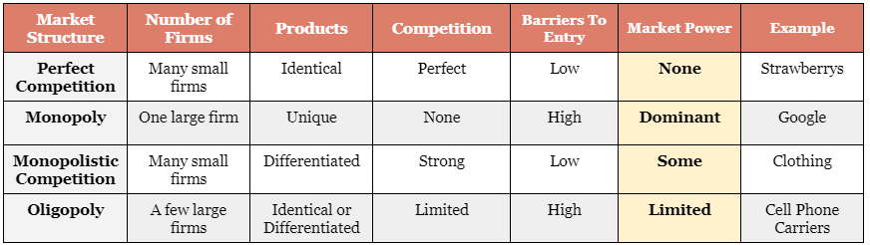
Summary of Market Structures
Perfect Competition
Monopoly
Monopolistic Competition
Oligopoly
Copyright Bananomics

Slide 11

Revenue
Copyright Bananomics

Slide 12


Revenue
Revenue is the amount of money that a firm earns. There are a few different types of revenue to consider.
Total Revenue = Price * Quantity
Marginal Revenue = The change in revenue of an additional quantity.
Average Revenue
TR
MR =
Q
TR
AR =
Q
Copyright Bananomics

Slide 13
Revenue
Revenue is largely determined by a firms ability to manipulate the price.
Perfectly Competitive firms have no control over price. Due to perfectly available substitutes, they are PRICE TAKERS meaning they take the price set by the market. The price is constant (perfectly elastic). Typically, they earn zero economic profit.
Imperfect Competitive firms are able to set the price and are therefore PRICE MAKERS. Typically they earn abnormal profits.
Copyright Bananomics

Slide 14
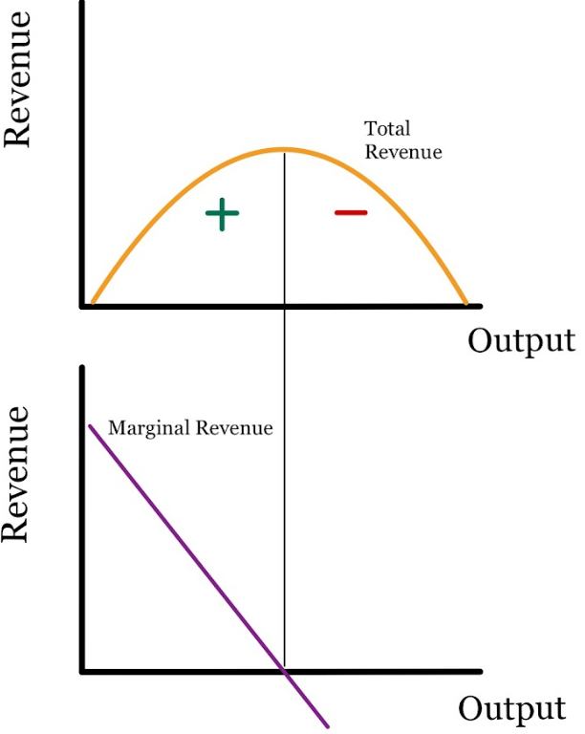
Total and Marginal Revenue
Copyright Bananomics

Slide 15

Costs
Copyright Bananomics

Slide 16

Costs
Total Cost = Cost * Quantity
Marginal Cost = The cost of producing one additional unit.
Average Cost
TC
MC =
Q
TC
AC =
Q
Copyright Bananomics

Slide 17


Economies of Scale
As a firm gets larger and more efficient, it is able to lower its costs making it more profitable.
Example:
A simple burger stall is operating and business is going well. The company then decides to open another location and upgrade all of its equipment. Due to their better equipment and second revenue source, they are then able to open larger more efficient burger stalls. They start making the burgers in a separate location and transport them to each individual store.
This example demonstrates how large fast-food chains, reduce their costs as they become larger and more efficient.
Copyright Bananomics

Slide 18
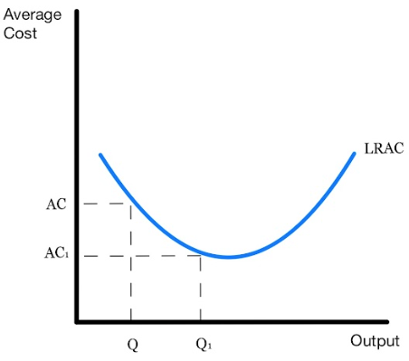
LRAC Diagram
Copyright Bananomics

Slide 19

Profit and Loss
Copyright Bananomics

Slide 20

Profit and Loss
Normal Profit (also known as Zero Economic Profit/Break-Even)
TR = TC
**Normal Profit does not mean that a firm is not making money. When economists determine costs, they also include opportunity costs in addition to the monetary (explicit) costs.
Abnormal Profit
TR > TC
Loss
TC > TR
Copyright Bananomics

Slide 21

The Relationship Between Cost and Output
Copyright Bananomics

Slide 22

Law of Diminishing Marginal Return
Copyright Bananomics

Slide 23

Definition
Short-Run
A period in time when at least one factor of production is fixed.
Long-Run
A period in time when all factors of production are variable.
Copyright Bananomics

Slide 24
Definition
The Law of Diminishing Marginal Returns
In the short-run when at least one capital resource is fixed, the addition of inputs (typically labour) will initially result in an increase in marginal returns but will eventually diminish marginally.
Copyright Bananomics

Slide 25
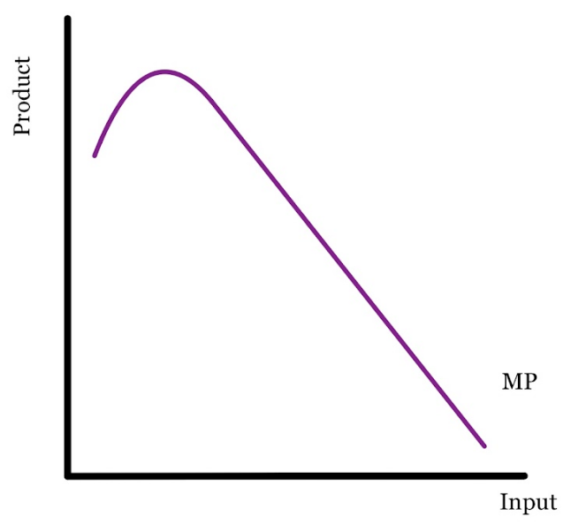
Marginal Product
As seen from this marginal product curve, initially the addition of inputs results in a significant increase in the product created. However, as more inputs are added, MP plateaus and begins to fall.
Copyright Bananomics

Slide 26

ACTIVITY
Paper Football Factory
Welcome to the paper football factory! You will have a limited supply of paper per round and limited space to produce these products! We will hire workers marginally and if you are not participating, you are tasked with charting our progress. Assume we are paying each worker 7 USD.
Copyright Bananomics

Slide 27

Paper Football Tutorial
YOUTUBE- FOLD SOMETHING
Copyright Bananomics

Slide 28
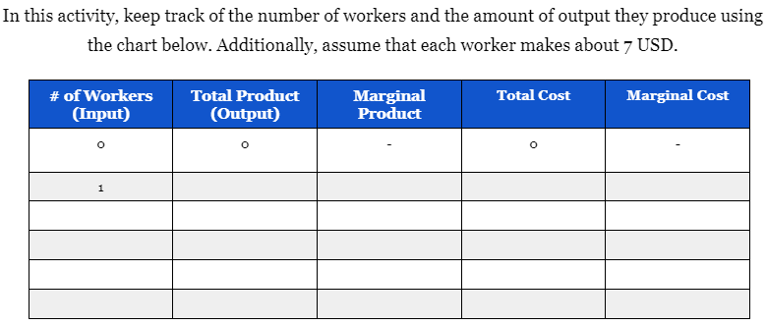
Activity Chart
Copyright Bananomics

Slide 29
ACTIVITY
Debrief
  What trends can you see from the data collected?
  Can you explain those trends? Why do they happen?
  What would change those trends?
Copyright Bananomics

Slide 30
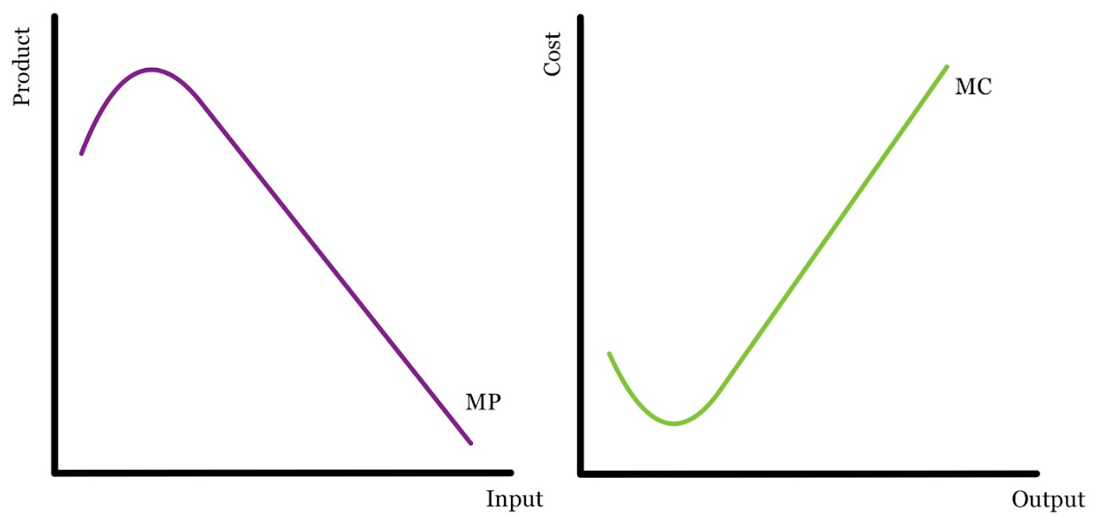
MP vs MC Chart
Due to the Law of Diminishing Marginal Returns, as output increases, a firm's marginal cost increases and marginal product decreases.
Copyright Bananomics

Slide 31
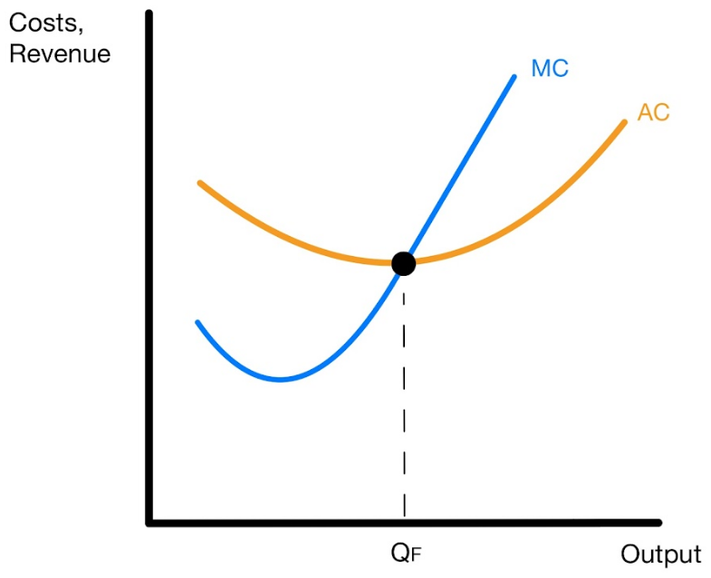
Standard Cost (MC and AC) Diagram
You will use MC and AC in every market structure diagram.
MC must intersect AC at it's minimum
Copyright Bananomics

Slide 32

Profit Maximizng Rule (MR = MC)
Copyright Bananomics

Slide 33


Profit Maximization
The single most important rule in Microeconomics . . .
MR = MC
The profit-maximizing rule is used by every firm in every market structure to determine the QUANTITY the firm should produce to maximize profits.
Copyright Bananomics

Slide 34

Perfect Competition
Copyright Bananomics

Slide 35
Perfect Competition
Perfect Competition
Characteristics
  Many small firms
  Identical/homogenous products (many perfect substitutes)
  Low barriers to entry (easy for firms to enter and exit the market)
  No market power = no control over price (Price Takers)
Example: Most agricultural products (strawberries, corn, potatoes)
Copyright Bananomics

Slide 36

Efficiency
Copyright Bananomics

Slide 37

Efficiency
Allocative Efficiency
Each market structure is evaluated on its allocation efficiency.
Achieved when just the right amount of goods and services are produced from society’s point of view so that scarce resources are allocated in the best possible way.
It is achieved when, for the last unit produced, price (P) is equal to marginal cost (MC).
Copyright Bananomics

Slide 38

Market Power
Copyright Bananomics

Slide 39

Market Power
Market Power is a measure of how much control a firm has over it's price.
Due to the characteristics, firms in perfectly competitive markets have NO MARKET POWER meaning they have no control over price.
They are called "Price Takers" as they must take whatever price is set by the market.
Copyright Bananomics

Slide 40



Price Takers
Why are all firms in perfect competition price takers?
Because of perfect substitutes, identical products, and large numbers of firms, if one firm tries to charge a higher price no one will purchase their goods.
This results in a perfectly elastic demand curve for firms in Perfect Competition.
Example: Which strawberry would you purchase?
A rational consumer would purchase either of the 1 coin strawberries rather than the 2 coin strawberries because they are identical products!
Copyright Bananomics

Slide 41
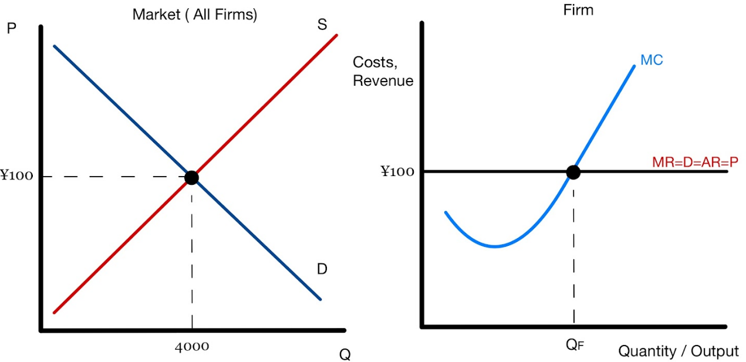
Perfect Competition Diagram
There are two diagrams put together side-by-side when drawing a firm that participates in Perfect Competition.
Additionally, because no firm has control over the price, the MR is also equal to the Price. Firms must take the price from the market - Price Takers. (MR=D=AR=P)
Copyright Bananomics

Slide 42

Practice
For each diagram:
  Determine the quantity that should be produced
  Determine the Total Revenue
  Determine the Total Cost
  Determine whether the firm is making an abnormal profit, a loss, or normal profit.
Copyright Bananomics

Slide 43
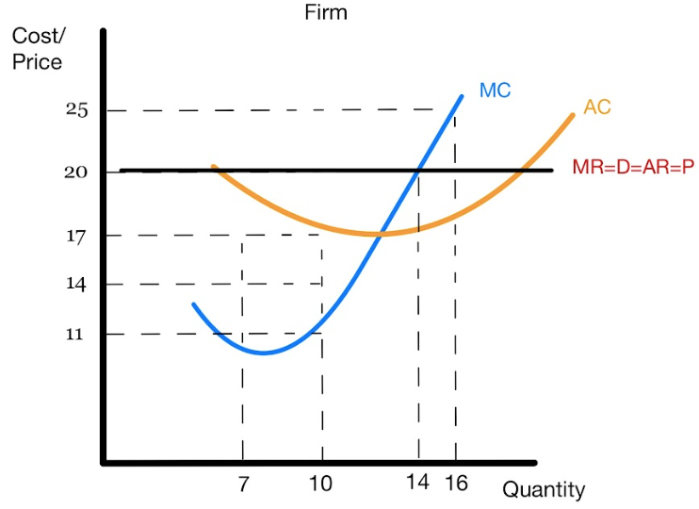
Practice #1
For each diagram:
  Determine the quantity that should be produced
  Determine the Total Revenue
  Determine the Total Cost
  Determine whether the firm is making an abnormal profit, a loss, or normal profit. How Much?
Copyright Bananomics

Slide 44
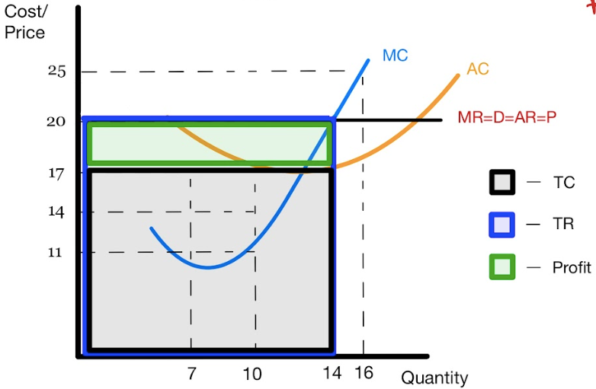
Practice #1
For each diagram:
  Determine the quantity that should be produced 14
  Determine the Total Revenue 280
  Determine the Total Cost 238
  Determine whether the firm is making an abnormal profit, a loss, or normal profit. Abnormal Profit; 42
Copyright Bananomics

Slide 45
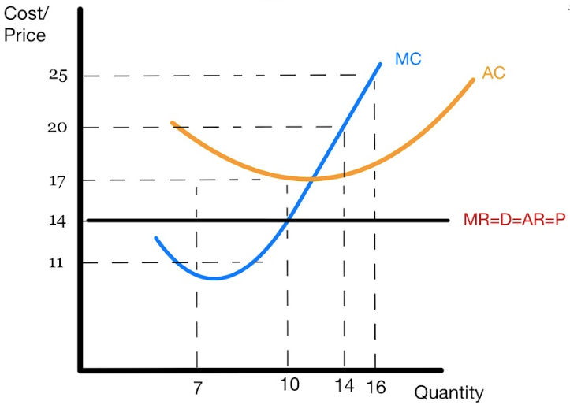
Practice #2
For each diagram:
  Determine the quantity that should be produced
  Determine the Total Revenue
  Determine the Total Cost
  Determine whether the firm is making an abnormal profit, a loss, or normal profit. How much?
Copyright Bananomics

Slide 46
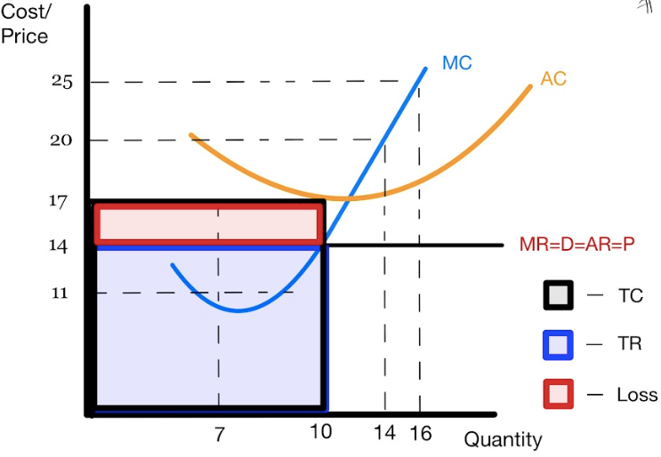
Practice #2
For each diagram:
  Determine the quantity that should be produced 10
  Determine the Total Revenue 140
  Determine the Total Cost 170
  Determine whether the firm is making an abnormal profit, a loss, or normal profit. Loss; 30
Copyright Bananomics

Slide 47
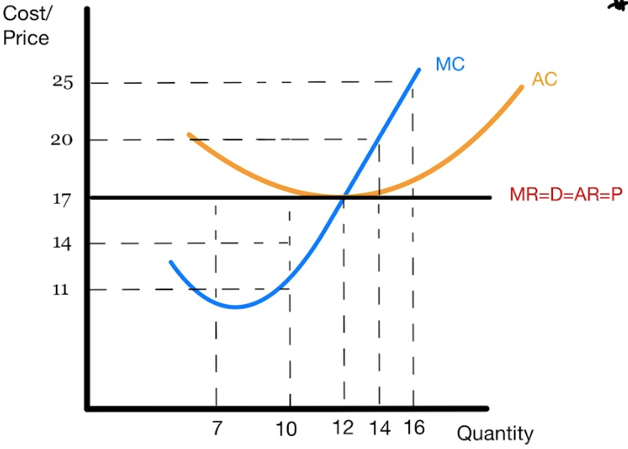
Practice #3
For each diagram:
  Determine the quantity that should be produced
  Determine the Total Revenue
  Determine the Total Cost
  Determine whether the firm is making an abnormal profit, a loss, or normal profit. How much?
Copyright Bananomics

Slide 48
Practice #3
For each diagram:
  Determine the quantity that should be produced 12
  Determine the Total Revenue 204
  Determine the Total Cost 204
  Determine whether the firm is making an abnormal profit, a loss, or normal profit. Normal Profit
Copyright Bananomics

Slide 49

Short-Run vs Long-Run
Copyright Bananomics

Slide 50
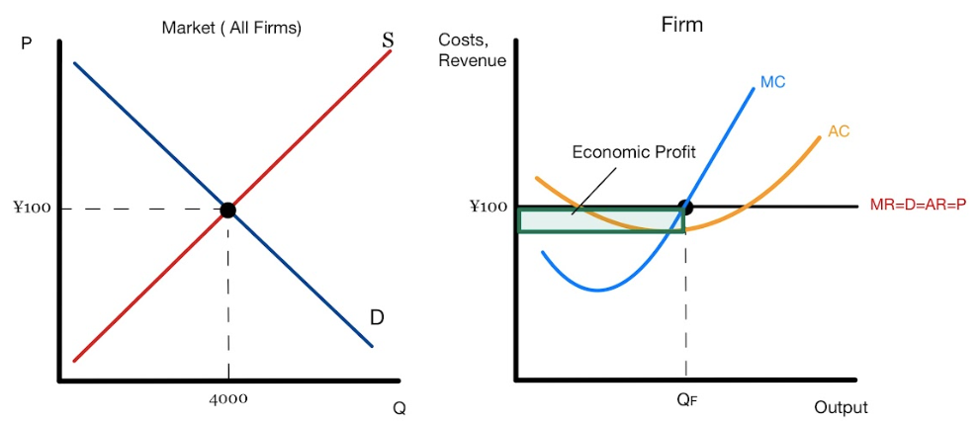
Short-Run Profits/Loss
Due to low barriers, firms are able to join, or leave, Perfect Competition with ease.
When firms make abnormal profits or losses in the short-run, other firms react by either leaving or entering the market.
If a firm is making abnormal economic profits, how do firms react?
Copyright Bananomics

Slide 51
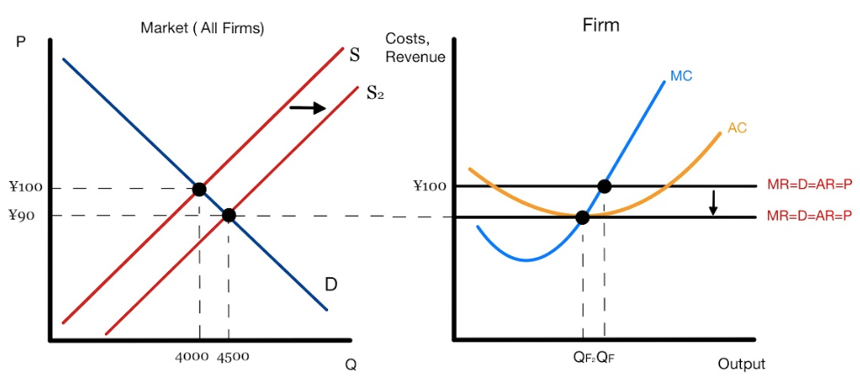
Adjustment to Long-Run
Abnormal profits attract new firms to join! As the numbers of firms increase, the market supply increases as number of firms is a shifter.
As firms join, the equilibrium price in the market decreases, and quantity increases. As firms are Price Takers, they adjust to the new price until eventually, everyone in the market makes normal economic profit.
Copyright Bananomics

Slide 52
Long-Run
In Perfect Competition:
  Firms can only make abnormal profits or losses in the SHORT-RUN
  ALL firms will make Normal Profit in the long run.
Copyright Bananomics

Slide 53

Try It Out
Draw a Perfectly Competitive Firm making a loss.
Then, draw how that firm will adjust in the Long-Run.
Copyright Bananomics

Slide 54
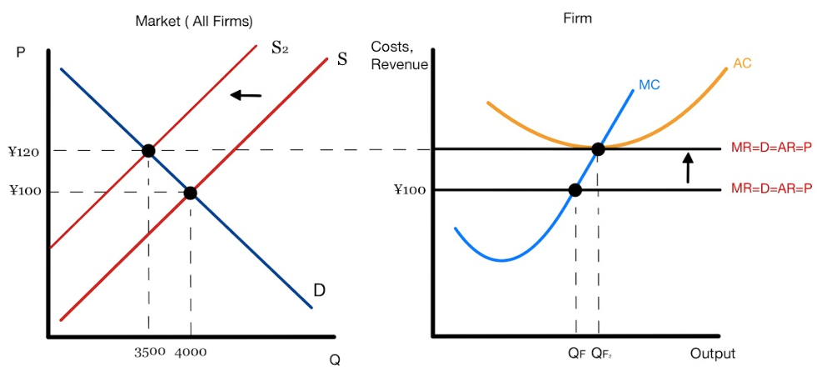
Try It Out
As firms earn losses, some will leave the market. Resulting in an increase in Price and normal profit.
Copyright Bananomics

Slide 55

Evaluation of Perfect Competition
Copyright Bananomics

Slide 56
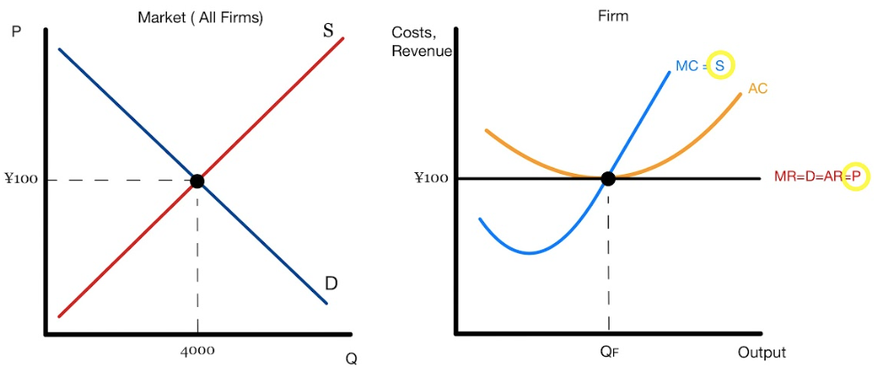
Efficiency
Perfect Competitive firms are perfectly efficient.
Firms with high costs are forced to exit the industry. Abnormal profit signals firms to join the market.
Profit Maximizing Perfectly Competitive firms are always Allocatively Efficient (P = MC)
Copyright Bananomics

Slide 57

Evaluation of Perfect Competition
Advantages of Perfect Competition
  Allocatively Efficient (P=MC)
  Offers the lowest price possible for consumers
  High competition ensures inefficient producers exit the market
  The market is very responsive to consumers taste/demand
Copyright Bananomics

Slide 58

Evaluation of Perfect Competition
Disadvantages of Perfect Competition
  Unrealistic
    There will always be imperfect information and products aren't truly identical
  No economies of scale
  Lack of product variety
  Unable to engage in R&D to improve efficiency
Copyright Bananomics

Slide 59

Monopoly
Copyright Bananomics

Slide 60
Monopoly
Perfect Competition
Monopoly
Characteristics
  Single/One dominant firm
  Unique product (No close substitutes)
  Extremely high barriers to entry (difficult for firms to enter and exit the market)
  Dominant market power = no control over price (Price Maker)
Example: NBA, Meta, Google, Local Electricity and Water Providers
Copyright Bananomics

Slide 61



Market Share
In reality, a Monopoly is measured by market share dominance rather than the number of firms .
Examples of firms with dominant market share:
  Google - 93%
  Nike Basketball Shoes - 80%
  Facebook - 65%
Copyright Bananomics

Slide 62


Natural Monopoly
A monopoly that can produce enough output to cover the entire needs of a market while still experiencing economies of scale. Its average costs will therefore be lower than those of two or more firms in the market
At times, a natural monopoly is preferred. When economies of scale make it impractical for multiple firms to participate, a natural monopoly is preferable.
Example:
A city's water utility service requires very large start-up costs and economies of scale. Therefore, if multiple firms joined, they would all pay similar start-up costs and develop economies of scale while also competing for customers and not receiving 100% of the market's revenue. As a result, some firms would not be profitable or the quality of the product (water) would become lower.
This example illustrates why natural monopolies are sometimes preferable. Typically natural monopolies are managed by the government and occur with utilities or public goods.
Copyright Bananomics

Slide 63

Sources of Market Power
  Economies of Scale
    Typically firms start small with limited expertise. Monopolists have the ability to charge a lower price than newcomers.
  Natural Monopoly
    Only enough revenue and economies of scale to support one firm
  Legal Barriers
    Patents, Copyright, Licenses, etc.
  Branding
    Customers may be loyal to a certain firm due to marketing. Kleenex, Band-Aid, etc.
  Anti-Competitive Behavior
    A monopolist can charge lower costs due to economies of scale. Therefore, they can lower their price to suffocate upcoming competitors.
Copyright Bananomics

Slide 64

Graphing Monopolies
Copyright Bananomics

Slide 65

Graphing A Monopoly
Key Components:
  Only one diagram. The singular firm IS the market.
  The cost curves are exactly the same (AC, MC)
  The profit Maximizing rule still worked to find the quantity. (MR=MC)
Copyright Bananomics

Slide 66
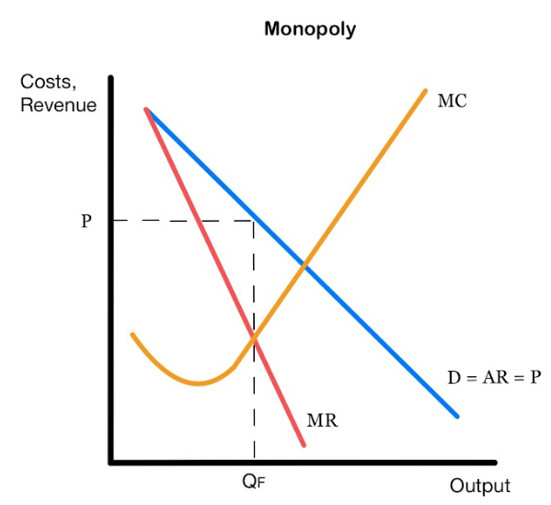
Monopoly Diagram
**No AC curve on this diagram**
Copyright Bananomics

Slide 67

Monopoly Diagram
The key difference between a monopoly diagram and perfect competition is that monopolies are able to set their price. So they do not set their price where MR = MC, just the quantity. The price monopolies sell at is the one which consumers are willing to pay (D).
Copyright Bananomics

Slide 68
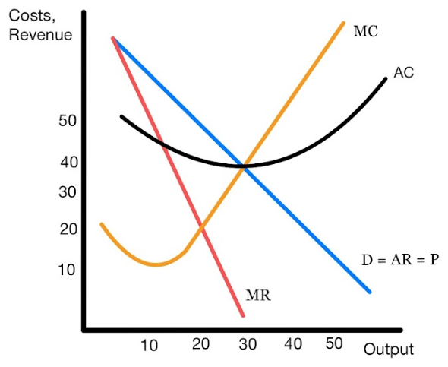

Practice
Analyze the diagram and determine:
  Quantity produced
  Price Sold
  Total Revenue
  Total Costs
  Normal Profit, Abnormal Profit, or Loss
  Allocatively Efficient Quantity
Copyright Bananomics

Slide 69
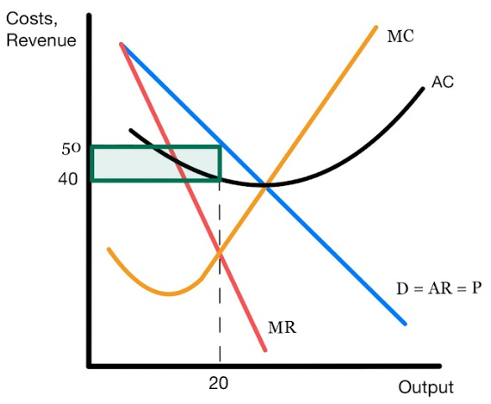
Practice
Analyze the diagram and determine:
  Quantity produced 20
  Price Sold 50
  Total Revenue 100
  Total Costs 80
  Normal Profit, Abnormal Profit, or Loss Abnormal Profit (20)
  Allocatively Efficient Quantity 30 (P = MC)
Copyright Bananomics

Slide 70


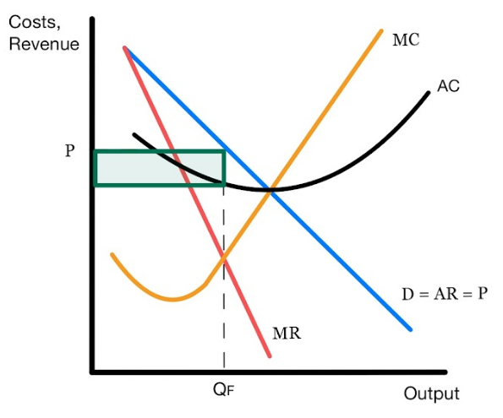
Monopoly Making Profit
Unlike perfect competition, Monopolies are able to make abnormal profits in the short and long-run.
Copyright Bananomics

Slide 71
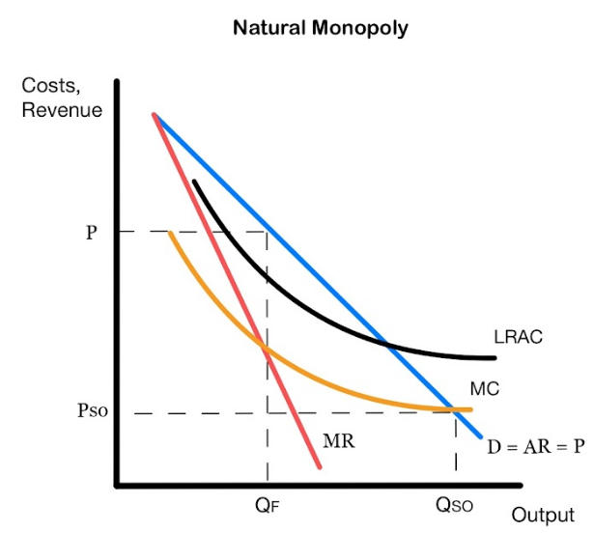


Natural Monopoly Diagram
Natural Monopolies MUST use economies of scale, therefore their AC and MC curves look different.
Copyright Bananomics

Slide 72

Evaluation of Monopolies
Copyright Bananomics

Slide 73

Evaluation of Monopoly
Are Monopolies allocatively efficient?
No! Monopolies are not allocatively efficient because they
  Don't produce where P = MC (Not Allocatively Efficient)
  Charge a higher price than they should
  Purposely don't produce enough in order to charge a higher price
Copyright Bananomics

Slide 74

Evaluation of Monopoly
Disadvantages of Monopolies
  Consumers pay a higher price and have a lower quantity available compared to perfect competition.
  Loss of consumer surplus
  Less Innovation as there is little incentive
  Market Failure, Allocative Inefficiency
  Lower quality of goods or services as no suitable alternatives are available
Copyright Bananomics

Slide 75

Evaluation of Monopoly
Advantages of Monopolies
  Economies of scale can allow for lower production costs and lower price
  Natural Monopolies - typically ensures basic utilities at affordable prices for communities
  Research & Development (Abnormal profits allow for funding to research)
Copyright Bananomics

Slide 76

Monopolistic Competition
Copyright Bananomics

Slide 77
Monopolistic Competition
Monopolistic Competition
Characteristics
  Many firms
  Differentiated products (Same-Same but different)
  Low barriers to entry (easy for firms to enter and exit the market)
  Limited market power
  Rely heavily on branding and advertising
Example: McDonald's, Starbucks, Etsy, Coca Cola, Adidas, Local restaurants
Copyright Bananomics

Slide 78

If Perfect Competition and Monopoly Had A Baby . . .
Monopolistic Competition!
Copyright Bananomics

Slide 79

Traits of Monopolistic Competition
Monopolistic Competition!
Monopoly
  Some control over price
  Similar looking graph (D > MR)
  Not Allocatively Efficient
Perfect Competition
  A large number of smaller firms
  Low Barriers to Entry
  In the Long-Run, Normal Profit.
Copyright Bananomics

Slide 80





Differentiated Products
Products are similar but slightly different
All shoes! But slightly different
Copyright Bananomics

Slide 81

Advertising and Branding
Because products are so similar, firms must attempt to differentiate their products as much as possible with marketing. Obtaining loyal customers leads to higher market power and the ability to raise price.
Examples of Marketing Strategies
  Packaging and Brand Name
  Service Quality
  Location
  Commercials
Copyright Bananomics

Slide 82
Graphing Monopolistic Competition
Copyright Bananomics

Slide 83
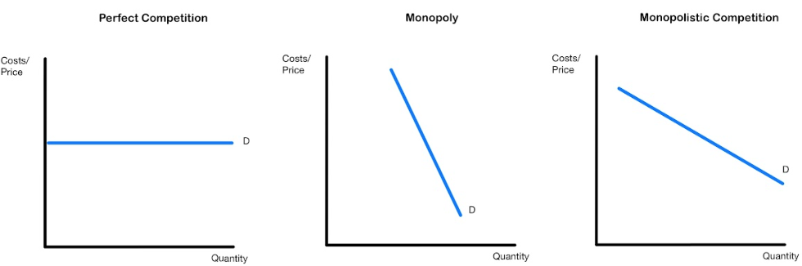
Graphing Monopolistic Competition
Key Components:
  Differentiation means MR is still not equal to demand but more firms offer substitutes so therefore, MR and Demand are more elastic.
  Abnormal profits and losses only in the short-run. Normal profit in the long-run
Copyright Bananomics

Slide 84
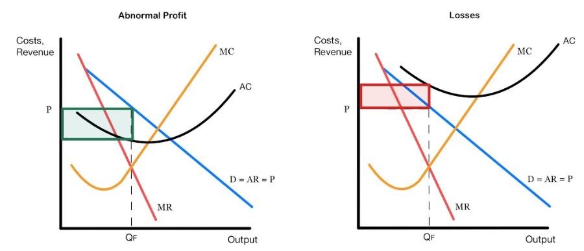
Graphing Monopolistic Competition
Copyright Bananomics

Slide 85
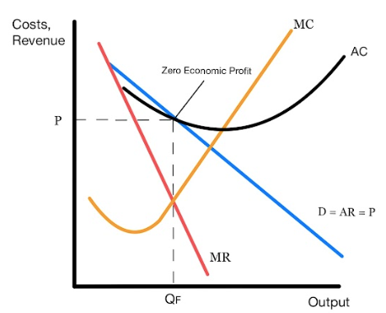
Graphing Monopolistic Competition
Due to low barriers of entry, profit will attract other firms to enter and steal demand. The demand curve will shift accordingly. In the long-run equilibrium, there will always be normal profit.
Copyright Bananomics

Slide 86
Evaluation of Monopolistic Competition
Copyright Bananomics

Slide 87
Efficiency
Not allocatively as they charge a higher price than they should. (P != MC)
Copyright Bananomics

Slide 88

Oligopoly
Copyright Bananomics

Slide 89
Oligopoly
Oligopoly
Characteristics
  A few large firms
  Identical or Differentiated products
  High barriers to entry (easy for firms to enter and exit the market)
  Limited market power
  Strong interdependence between firms
Example: Gas Stations, Airlines, Internet/Mobile Providers,
Copyright Bananomics

Slide 90
Sources of Market Power
  Economies of Scale
  High Start-Up Costs
  Ownership of Raw Materials
Copyright Bananomics

Slide 91

Interdependence
Definition
the dependence of two or more people or things on each other.
In an oligopoly, each firm has a significant share of market power and can therefore influence the market. Therefore, each firm must monitor other firms closely.
Copyright Bananomics

Slide 92


Interdependence
Oligopolies have an incentive to collude (work together to set prices). If Oligopolies collude, they essentially become a monopoly.
Simultaneously, firms may also desire to compete with one another to gain higher market shares.
Copyright Bananomics

Slide 93
Interdependence
Competing firms may try to always set the lowest prices, but this can trigger a price war, which would result in both firms losing profit.
Copyright Bananomics

Slide 94
How to tell if an industry is an Oligopoly, Monopoly, or Monopolistic Competition?
Use a Concentration Ratio
CR4 Ratio takes 4 of the largest firms and measures their combined market share concentration.
Market Share
0%
Low Concentration
50%
Medium Concentration
80%
High Concentration
100%
Perfect Competition
Monopolistic Competition
Oligopoly
Monopoly
Copyright Bananomics

Slide 95

Game Theory
Copyright Bananomics

Slide 96

Definition
Game Theory
The study of how individuals behave in strategic situations.
When using game theory, you make decisions based on what your opponent will likely do. (Interdependence)
Copyright Bananomics

Slide 97
John Nash Game Theory - A Beautiful Mind

Slide 98

Interdependence
Because Oligopolies are interdependent, firms engage in interdependent strategic thinking.
Do these firms have an incentive to Collude? Or Compete?
Copyright Bananomics

Slide 99

Collusion
When firms collude, they act as one large firm and are able to set prices high to make abnormal profits.
A colluding oligopoly (Cartel) essentially behaves like a monopoly. Colluding between firms is typically illegal.
Copyright Bananomics

Slide 100

Compete
Firms also have an incentive to compete by lowering prices to gain market share. Greater market share leads to more price control and greater revenue.
Copyright Bananomics

Slide 101
Ted Talk - Game Theory

Slide 102

Game Theory Matrix
Copyright Bananomics

Slide 103

Prisoners Dilemma
You and your friend rob a bank and get caught. Now the police are questioning, put yourself in the position of either Prisoner A or B. What should you do, confess or stay silent? Why?
Prisoner B
Stay Silent
Confess
A serves 5 years
B goes free
Stay Silent
Both serve 1 Year
Prisoner A
B serves 5 years
A goes free
Confess
Both serve 3 years
Copyright Bananomics

Slide 104
Dominant vs Non-Dominant
Dominant Strategy - There is one choice you should always make, regardless of your opponent's decision.
Non-Dominant Strategy - Your best choice is dependent upon your opponent's decision
Firm B
Price High
Price Low
Does one firm in this matrix have a dominant strategy?
Explain in writing.
$100 Profit
$60 Profit
Price High
$50 Profit
$90 Profit
Firm A
$50 Profit
$20 Profit
Price Low
$40 Profit
$10 Profit
Copyright Bananomics

Slide 105

Dominant vs Non-Dominant
Firm A has a dominant strategy to always price high (100>50 and 60>20).
Firm B does not have a dominant strategy.
Firm B
Price High
Price Low
- Firm A
$100 Profit
$60 Profit
- Firm B
Price High
$50 Profit
$90 Profit
Firm A
$50 Profit
$20 Profit
Price Low
$40 Profit
$10 Profit
Copyright Bananomics

Slide 106
Nash Equilibrium
When firms choose the optimal outcome with no incentive to change.
Since Firm A will always go high, Firm B will always price low. Neither firm has an incentive to change.
Firm B
Price High
Price Low
- Firm A
$100 Profit
$60 Profit
- Firm B
Price High
$50 Profit
$90 Profit
Firm A
$50 Profit
$20 Profit
Price Low
$40 Profit
$10 Profit
Copyright Bananomics

Slide 107

Practice
What is each firm's dominant strategy? Explain why.
Is there a Nash Equilibrium? Explain why.
Price High
Price Low
$90 Profit
$50 Profit
Price High
$40 Profit
$60 Profit
Firm A
$80 Profit
$70 Profit
Price Low
$70 Profit
$80 Profit
Copyright Bananomics

Slide 108
Practice
Firm A - No dominant strategy
Firm B - Dominant strategy of pricing low always
Price High
Price Low
$90 Profit
$50 Profit
Price High
$40 Profit
$60 Profit
Firm A
$80 Profit
$70 Profit
Price Low
$70 Profit
$80 Profit
Copyright Bananomics

Slide 109

Non-Price Competition
Copyright Bananomics

Slide 110



Non-Price Competition
Since firms in oligopolies prefer to avoid engaging in a price war, they must find alternative ways to gain market power and compete in alternative ways such as:
  Branding, advertising, free delivery, packaging, rewards,
Copyright Bananomics

Slide 111

Evaluation of Oligopoly
Copyright Bananomics

Slide 112

Evaluation of Oligopoly
Advantages
  Economies of Scale can be achieved
  Abnormal profit allows for Research and Development for technological innovation
Copyright Bananomics

Slide 113
Evaluation of Oligopoly
Disadvantages
  Not allocatively efficient
  Higher prices and lower quantities than perfect competition
  Less innovative due to lack of competition
  Potential for illegal collusion
Copyright Bananomics

Slide 114

Review
Copyright Bananomics

Slide 115
Venn Diagram
Create a Venn Diagram with each market structure and list unique features but also similarities.
Monopolistic Competition
Monopoly
Perfect Competition
Oligopoly
Copyright Bananomics

Slide 116

Government Responses to Market Dominance
Copyright Bananomics

Slide 117

Government Intervention
Governments may intervene to attempt to solve market power dominance by the use of:
  Legislation
    They could put laws in place to prevent the 4 largest companies from gaining more than 60% of the market share.
  Government Ownership (Nationalisation)
    Governments could take over an industry to reduce the abuse of market dominance. (Utilities)
  Regulation
    Governments can set up regulations designed to limit market shares such as licensing, inspections, or the issuing of fines.
Copyright Bananomics

Slide 118

Practice Question
Copyright Bananaomics

Slide 119
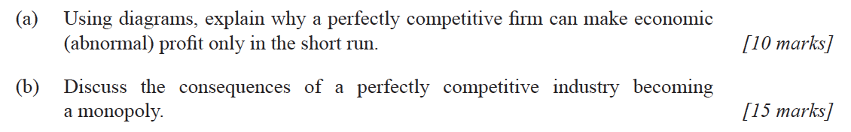
Paper 1
Copyright Bananaomics

Slide 120
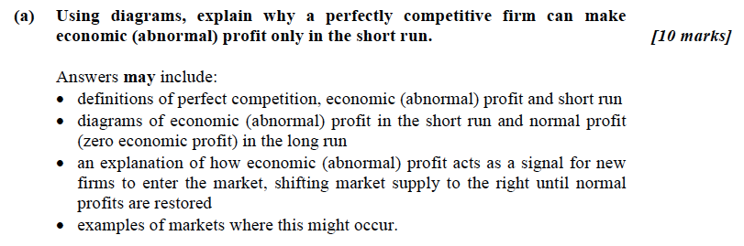
Mark Scheme
Copyright Bananaomics

Slide 121
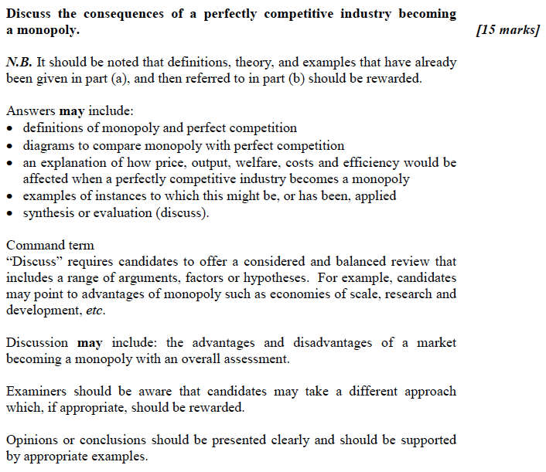
Mark Scheme
Copyright Bananaomics

Slide 122

Enjoying The Content?
Visit bananaomics.com to purchase package deals with discount prices!
BANANAOMICS

